Slide 1


Sky Talk
“Automated Testing”
Or: how tools make software better
Anthony McKale
Principal Software Engineer
24/11/2021

Slide 2
HOMOUR WARNING
Testing is important .
Not testing is bad for you, and bad for your projects

Slide 3
HOMOUR WARNING
Good Testing is Good Security
.
More Bugs ===
More Security Flaws

Slide 4
HOMOUR WARNING
This talk is advocating
more automated testing

Slide 5
Agenda
10 short minutes to explain why testing pipelines are only needed by muggles and NASA
* Aimed at developers, apologises for unexplained confusing terms

Slide 6
Agenda
LINTING : All code is excellent
UNIT TESTING: Developers never write bugs
INTER. TESTING: Software always works together
SCA TESTING: Applications do not grow old

Slide 7
Linting: All code is excellent
we can agree, developers:
create good clean code
understand their languages perfectly
… Javascript is a easy

Slide 8
Linting: All code is excellent
Linting* is hence pointless
* linter: a tool designed to hurt your feelings, when code is executing fine
but malformed

Slide 9
Linting: All code is excellent
“Audience Participation” : Javascript is easy
“which lines return true ?”

Slide 10
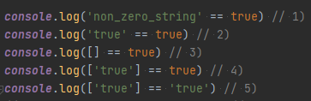
Linting: All code is excellent
“which lines return true ?”

Slide 11
Linting: All code is excellent
“which lines return true ?”

Slide 12
Linting: All code is excellent
“which lines return true ?”

Slide 13
Linting: All code is excellent
“which lines return true ?”

Slide 14
Linting: All code is excellent
“which lines return true ?”

Slide 15
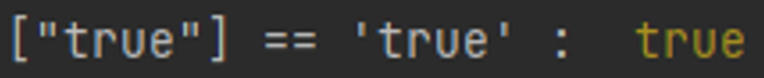
Linting: All code is excellent
“which lines return true ?”
Obviously, the winner is :

Slide 16
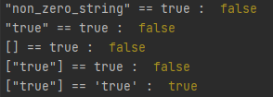
Linting: All code is excellent
WAT…

Slide 17
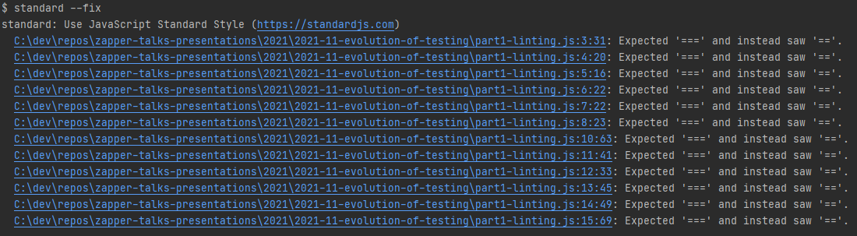
Linting: All code is excellent
Maybe making code boring* with linting isn’t such a bad idea
* Boring = Easy to read / Predicable

Slide 18
Linted code looks excellent
So “Linting” is ok

Slide 19
Unit Testing: Devs never write bugs
we can agree, developers:
never write bugs
understand their code
… Javascript can count

Slide 20
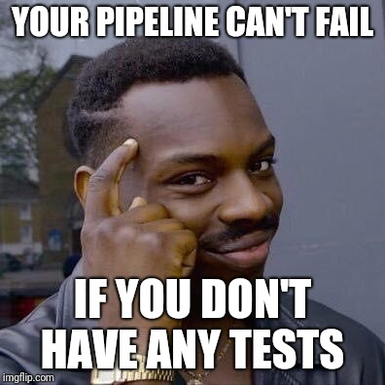
Unit Testing: Devs never write bugs
hence Unit Testing is pointless
https://www.reddit.com/r/ProgrammerHumor/comments/8fbgcp/unit_tests_ha/

Slide 21
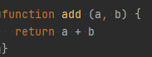
Unit Testing: Devs never write bugs
You do NOT ever need to test this code
This works for ALL inputs, ALL the time

Slide 22
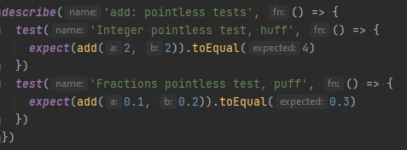
Unit Testing: Devs never write bugs
Unit Testing that this code is perfect .
(2 + 2 = 4) and (0.1 + 0.2 = 0.3)

Slide 23
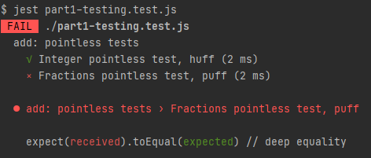
Unit Testing: Devs never write bugs
WAT…

Slide 24
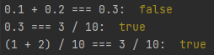
Unit Testing: Devs never write bugs
so … Javascript isn’t good at counting decimal fractions
Details for the interested :

Slide 25
Tested code has less bugs
So “Unit Tests” are good

Slide 26
Testing: Code always works together
we can agree, software has:
Good input sanitisation
Common i/o metric units
Same time zones
Only idiots would spend years building systems that didn’t work together…

Slide 27

Testing: Code always works together
hence Integration Testing is pointless
https://www.youtube.com/watch?v=0GypdsJulKE

Slide 28
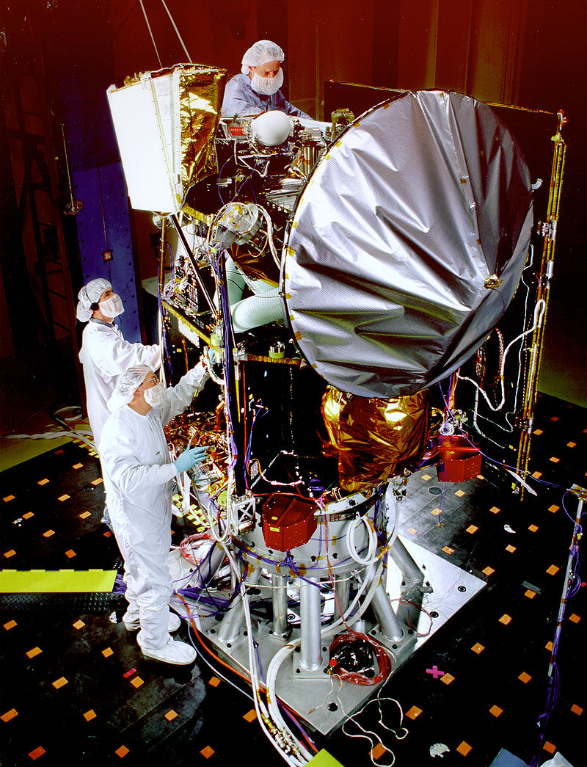
Testing: Code always works together
NASA’s Mars Climate Orbiter ’98

Slide 29
Testing: Code always works together
NASA’s Mars Climate Orbiter ‘98
System A (Onboard ECU):
Asked for newtons per sq meter
for thrusters

Slide 30
Testing: Code always works together
NASA’s Mars Climate Orbiter ’98
System B (Ground Control Computer):
Gave pounds per sq meter for thrusters

Slide 31
Testing: Code always works together
NASA’s Mars Climate Orbiter ’98
What happened next ?
System A:
Input is in newtons per sq meter
System B:
Output is in pounds per sq meter

Slide 32

Testing: Code always works together
A $327 million Rocket blewup
So… NASA blow up the odd spaceship
Maybe integration testing could of helped
https://en.wikipedia.org/wiki/Mars_Climate_Orbiter

Slide 33
Testing: Software needs field testing
So maybe “Integration Tests” are useful

Slide 34
Applications never grow old
I think we can agree, all software:
does not age
semver* updates carry no risk
dependencies are safe forever
… Javascript is secure
* Semantic Versioned

Slide 35
Applications never grow old
SCA (Software Component Analysis)* is hence pointless
* Github adv. security (many) / eze (many) / npm_audit (node) / dependency_check (java) / safety (python) ….

Slide 36
Applications never grow old: 1
Software doesn’t age, once deployed you never have new issues

Slide 37
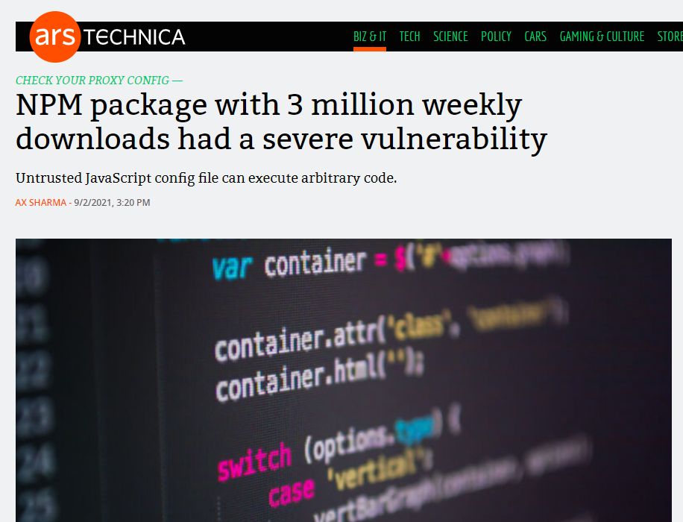
Applications never grow old: 1
Software doesn’t age, once deployed you never have new issues … never

Slide 38
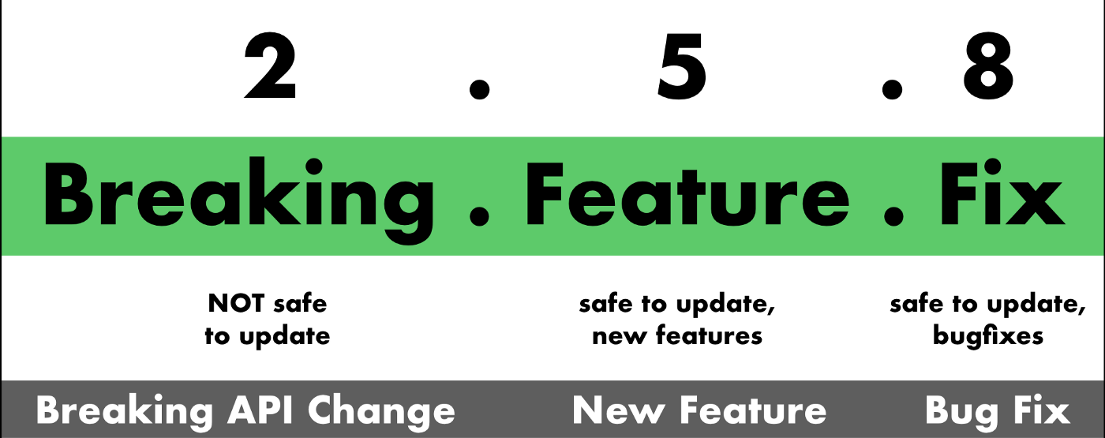
Applications never grow old: 2
* Semantic Versioning Primer
.
Given a version number MAJOR.MINOR.PATCH
https://blog.greenkeeper.io/introduction-to-semver-d272990c44f2

Slide 39
Applications never grow old: 2
Semantic versioning makes updating dependencies risk free

Slide 40
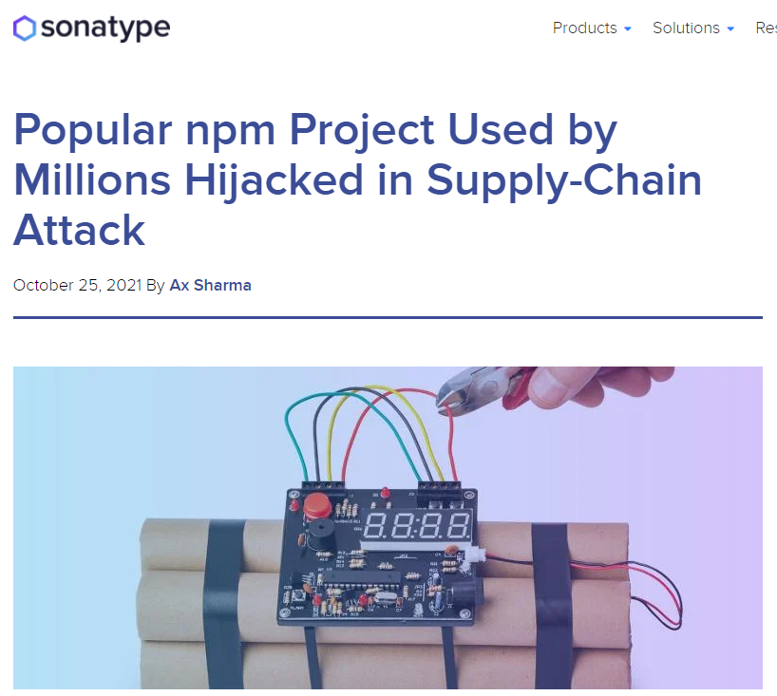
Applications never grow old: 2
Semantic versioning makes updating dependencies risk free
Supply-chain attacks take over repos, and upload compromised trivial versions

Slide 41
Applications never grow old: 2
Supply-chain attacks
Remember:
Library can attack the user (run time)
Library can attack the CI (install / build time)
[npm] dependencies trees run deep

Slide 42
Applications never grow old
dependencies are safe forever

Slide 43
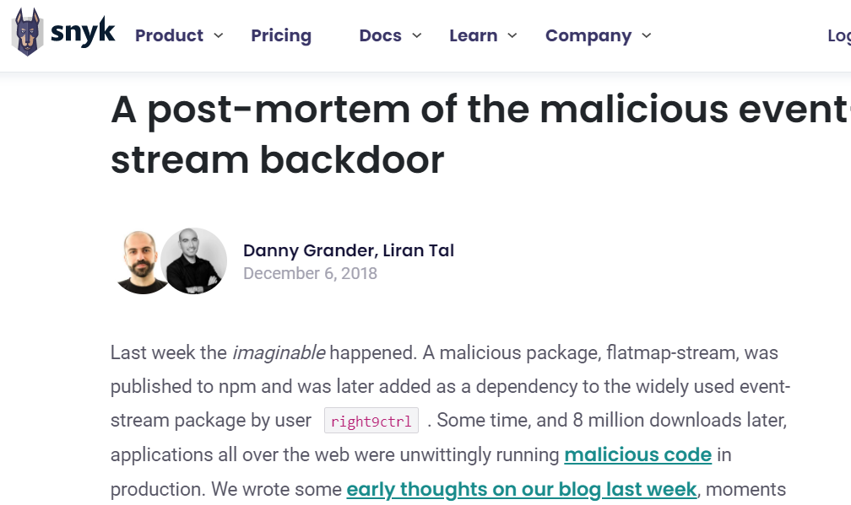
Applications never grow old
dependencies are safe forever
but they have non-safe sub-dependencies
https://snyk.io/blog/a-post-mortem-of-the-malicious-event-stream-backdoor/

Slide 44

Applications never grow old
dependencies are safe forever
but they have non-safe sub-dependencies
https://imgflip.com/i/5v8jfw

Slide 45
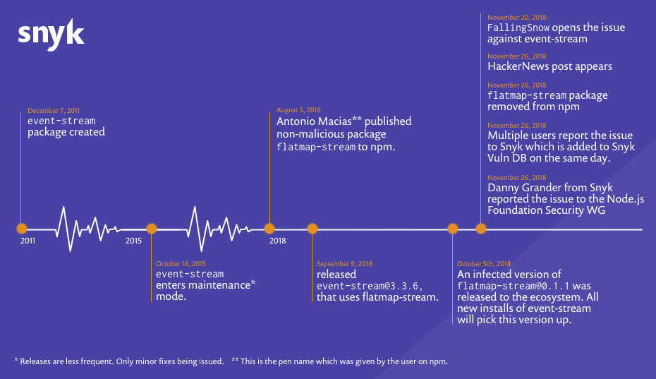
Applications never grow old
46 days of Event Stream exploitation
https://snyk.io/blog/a-post-mortem-of-the-malicious-event-stream-backdoor/

Slide 46
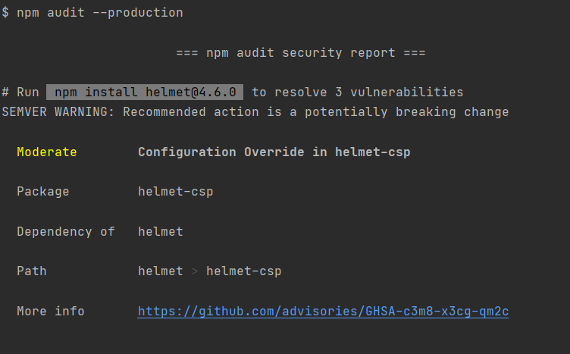
All Applications get old
Maybe… run SCA tools regularly to catch new vulnerable dependencies
Just for the muggles obviously

Slide 47
Conclusion
So, I think we can agree
“Lint”, “Unit Tests”, “Integration Tests”, “SCA Tools” are good for test pipelines
Deep down we’re all muggles
(even if you work for NASA)

Slide 48
Questions
I’ve been Anthony “Zapper” M^{c}Kale
Hopefully I’ve Educated, Informed, and even Entertained Good Testing is Good Security

Slide 49
Thank you

